Slide 1


Verification of Test-Taker
By-
Akash Singh
Rishikesh Bachhav
Sahil Rahate
Project Guide-
Miss. Sukeshini Ramadasu

Slide 2
Abstract
The "Verification of Test-Taker" project implements facial recognition technology to enhance online assessment security. The system verifies test-taker identities using facial images. This project addresses hardware, network, and accessibility considerations, contributing to secure remote assessments and fostering trust in online examination integrity.

Slide 3
Introduction
In the age of virtual learning, the "Verification of Test-Taker" project introduces a facial recognition-based solution to reinforce the security of online exams. With the shift from physical to remote assessments, maintaining test-taker authenticity is vital.
By addressing the challenges of impersonation and unauthorized access, the project bridges technology and education to ensure the integrity of modern assessment practices.

Slide 4
Road Map
1. Webcam
2. Graphics
3. Encoding Generator
4. Face Recognition
5. Database Setup
6. Add data & images to Database
7. Realtime-Data base Update

Slide 5
Basic code for accessing camera
import cv2 cap = cv2.VideoCapture(0) cap.set(3, 1280) cap.set(4, 720) while True: success, img = cap.read() cv2.imshow("FaceTest", img) cv2.waitKey(1)
In this code, the cv2 (OpenCV) library is used to access and display frames from a camera. The script initializes the camera, sets its resolution to 1280x720 pixels, and then enters a loop that captures frames from the camera and displays them in a window named "FaceTest." The loop continues until the user presses a key.

Slide 6
Giving background to the webcam
import cv2 cap = cv2.VideoCapture(0) cap.set(3, 640) cap.set(4, 480) imgBackgroud = cv2.imread('Resources/background.png') while True: success, img = cap.read() imgBackgroud[162:162+480, 55:55+640] = img # cv2.imshow("Webcam", img) cv2.imshow("FaceTest", imgBackgroud) cv2.waitKey(1)
In this code, a background image (background.png) is loaded, and then the captured camera frame is overlaid onto this background. The code then displays the modified image with the camera frame overlay.
This code creates a fun effect of overlaying the camera frame onto a background image. Make sure to have the OpenCV library installed and the background.png image available in the specified directory.

Slide 7

This is the Background for GUI which we are using

Slide 8
Importing mode images.
import cv2 import os cap = cv2.VideoCapture(0) cap.set(3, 640) cap.set(4, 480) imgBackgroud = cv2.imread('Resources/background.png') #importing the Modes images: folderModePath = 'Resources/Modes' modePathList = os.listdir(folderModePath) imgModeList = [] for path in modePathList: imgModeList.append(cv2.imread(os.path.join(folderModePath,path))) while True: success, img = cap.read() imgBackgroud[162:162+480, 55:55+640] = img imgBackgroud[44:44 + 633, 808:808 + 414] = imgModeList[0] # cv2.imshow("Webcam", img) cv2.imshow("FaceTest", imgBackgroud) cv2.waitKey(1)
This code captures video from the camera using OpenCV, applies visual effects, and displays the result.
This code enhances the camera input by overlaying the camera frame and mode images onto a background. Make sure to have the OpenCV library installed and the required images available in their respective folders.

Slide 9


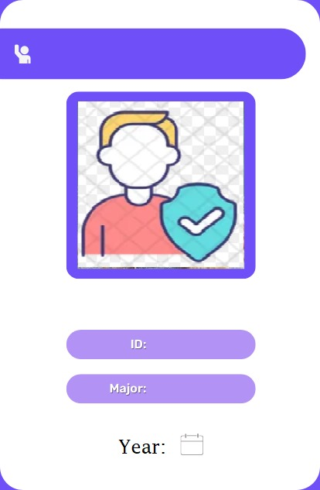

These are the images we are using for displaying Modes

Slide 10
Encoding the images
import cv2 import face_recognition import pickle import os #importing the face images: folderPath = 'Images' pathList = os.listdir(folderPath) print(pathList) imgList = [] ids = [] for path in pathList: imgList.append(cv2.imread(os.path.join(folderPath,path))) # print(os.path.splitext(path)[0]) checking ids.append(os.path.splitext(path)[0]) #implementing print(len(imgList)) print(ids)
This code leverages the OpenCV and face_recognition libraries to process and encode face images for identification.
In summary, the code processes face images to create facial encodings, associates each encoding with its corresponding id, and saves this data to a file for later recognition purposes.

Slide 11
def findEncodings(imagesList): encodeList = [] for img in imagesList: img = cv2.cvtColor(img, cv2.COLOR_BGR2RGB) encode = face_recognition.face_encodings(img)[0] encodeList.append(encode) return encodeList print("Encoding Started") encodeListKnown = findEncodings(imgList) encodeListKnownWithIds = [encodeListKnown, ids] # print(encodeListKnown) print("Encoding Completed") file = open("EncodeFile.p", 'wb') pickle.dump(encodeListKnownWithIds, file) file.close() print("File Saved")

Slide 12
Loading the encoder
This code loads previously stored face encodings and ids from the serialized file 'EncodeFile.p’.
In summary, this code retrieves previously stored face encodings and their corresponding ids from the serialized file 'EncodeFile.p', making them available for further processing and recognition.
print("Loading Encode file ....") file = open("EncodeFile.p", 'rb') encodeListKnownWithIds = pickle.load(file) encodeListKnown, ids = encodeListKnownWithIds print(ids) print("Encode file loaded")

Slide 13
Using Face_recognition library
mgS = cv2.resize(img, (0, 0), None, 0.25, 0.25) imgS = cv2.cvtColor(img, cv2.COLOR_BGR2RGB) faceCurFrame = face_recognition.face_locations(imgS) encodeCurFrame = face_recognition.face_encodings(imgS, faceCurFrame) imgBackground[162:162 + 480, 55:55 + 640] = img imgBackground[44:44 + 633, 808:808 + 414] = imgModeList[0] for encodeFace, faceLoc in zip(encodeCurFrame, faceCurFrame): matches = face_recognition.compare_faces(encodeListKnown, encodeFace) faceDis = face_recognition.face_distance(encodeListKnown, encodeFace) # print("matches", matches) # print("face", faceDis) matchIndex = np.argmin(faceDis) print("Student Id", ids[matchIndex])
iThis code segment appears to be similar to the previous one, focusing on the face recognition process. It processes captured frames, detects faces, encodes them, and performs recognition based on known encodings.
In summary, this code performs face recognition on the captured frame, compares it with known encodings, identifies the closest match, and prints the associated student id. It's similar to the previous code but focuses on the recognition process.

Slide 14
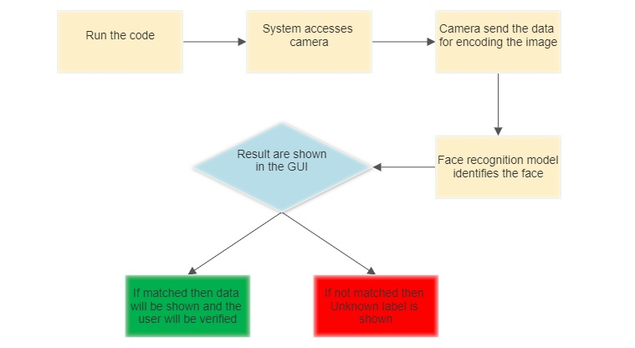
Flow Chart for functioning of code

Slide 15
Firebase Realtime Database Integration
mgS = cv2.resize(img, (0, 0), None, 0.25, 0.25)
imgS = cv2.cvtColor(img, cv2.COLOR_BGR2RGB)
faceCurFrame = face_recognition.face_locations(imgS)
encodeCurFrame = face_recognition.face_encodings(imgS, faceCurFrame)
imgBackground[162:162 + 480, 55:55 + 640] = img
imgBackground[44:44 + 633, 808:808 + 414] = imgModeList[0]
for encodeFace, faceLoc in zip(encodeCurFrame, faceCurFrame):
matches = face_recognition.compare_faces(encodeListKnown, encodeFace)
faceDis = face_recognition.face_distance(encodeListKnown, encodeFace)
matchIndex = np.argmin(faceDis)
print("Student Id", ids[matchIndex])
This code segment uses the pyrebase library to add student details to a Firebase Realtime Database. It iterates through a dictionary containing student information and pushes each student's data to the database using their unique keys.
In summary, this code uploads student details to a Firebase Realtime Database using Python and the pyrebase library. Make sure you have the necessary Firebase configuration and the pyrebase library installed for successful execution.

Slide 16
Continuation of the code…
data = {
"230350125034": {
"name": "Kundan Patil",
"course": "DBDA",
"starting_year": 2023,
"last_login_time": "2023-08-18 00:30:34"
},
"230350125041": {
"name": "Manoj Gaikwad",
"last_login_time": "2023-08-18 00:30:34"
},
"230350125062": {
"name": "Rakesh Singh",
"course": "DBDA",
"starting_year": 2023,
"last_login_time": "2023-08-18 00:30:34"
},
# ... (other data entries)
}
for key, value in data.items():
ref.child(key).set(value)

Slide 17
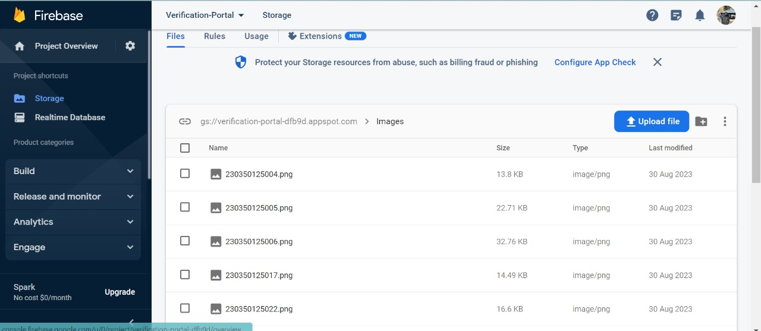
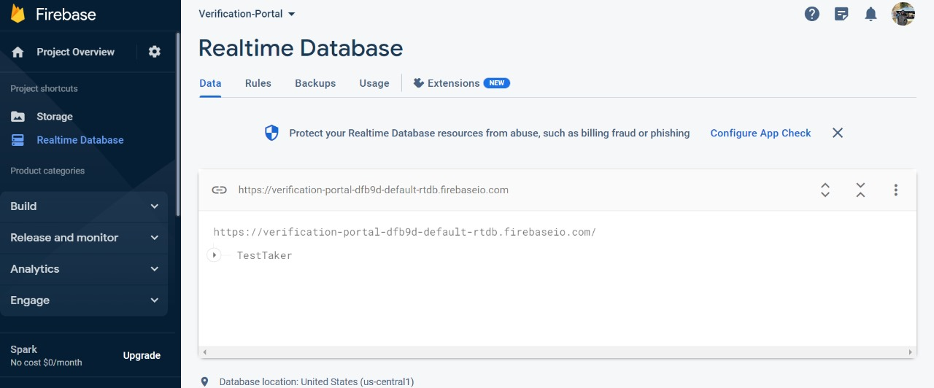
Firebase Database Structure and Sample Entries

Slide 18
Various applications of this Project
Secure Test-Taker Identity Verification:
Enhances the integrity of online assessments by accurately verifying the identity of test takers through facial recognition.
Prevents impersonation and cheating during remote exams, ensuring fairness and credibility.
Fraud Prevention in Online Assessments:
Detects and prevents impersonation attempts by cross-referencing test taker identities with a verified database.
Enhances the reliability of assessment results and maintains the authenticity of educational outcomes.
Enhanced Test Security and Integrity:
Augments the credibility of online assessments by employing advanced biometric identification.
Safeguards the value of certifications and degrees by upholding the authenticity of test results.
Reduced Administrative Burden:
Streamlines attendance tracking and verification processes, reducing administrative workload.
Frees up resources for more valuable educational tasks.
Future-Ready Educational Platforms:
Paves the way for the integration of facial recognition technology in educational systems of the future.
Adapts to the evolving landscape of remote and digital learning.
Customized Test Environment:
Recognizes authorized test takers and personalizes the test environment to their preferences.
Creates a secure and tailored assessment experience for each individual.

Slide 19
Conclusion
We achieved a significant milestone by successfully implementing facial recognition for our "Verification of Test-Taker" system. This aligns with our goal of enhancing online assessment security. Now, as we complete the project, we're proud to announce the successful deployment of our system, reinforcing our commitment to secure online education.

